Slide 1
Performing Basic Linux Tasks
Identify the Linux Design Philosophy
Enter Shell Commands
Get Help with Linux

Slide 2

Topic A: Identify the Linux Design Philosophy
Exam Objectives:
This topic does not cover specific exam syllabus objectives or content examples.

Slide 3
Open Source Software (Slide 1 of 2)
Computer code that any user is permitted to view, copy, and modify for any reason, as well as distribute to anyone.
Users are granted rights when author releases source code under an OSS license.
Opposite of proprietary software.
Released under a license that restricts rights.
Provides several advantages.
Encourages ongoing improvement of software.
Encourages collaboration and community-driven development.
Developers can customize/enhance others' code.
No legal issues.
The Linux kernel is OSS.

Slide 4
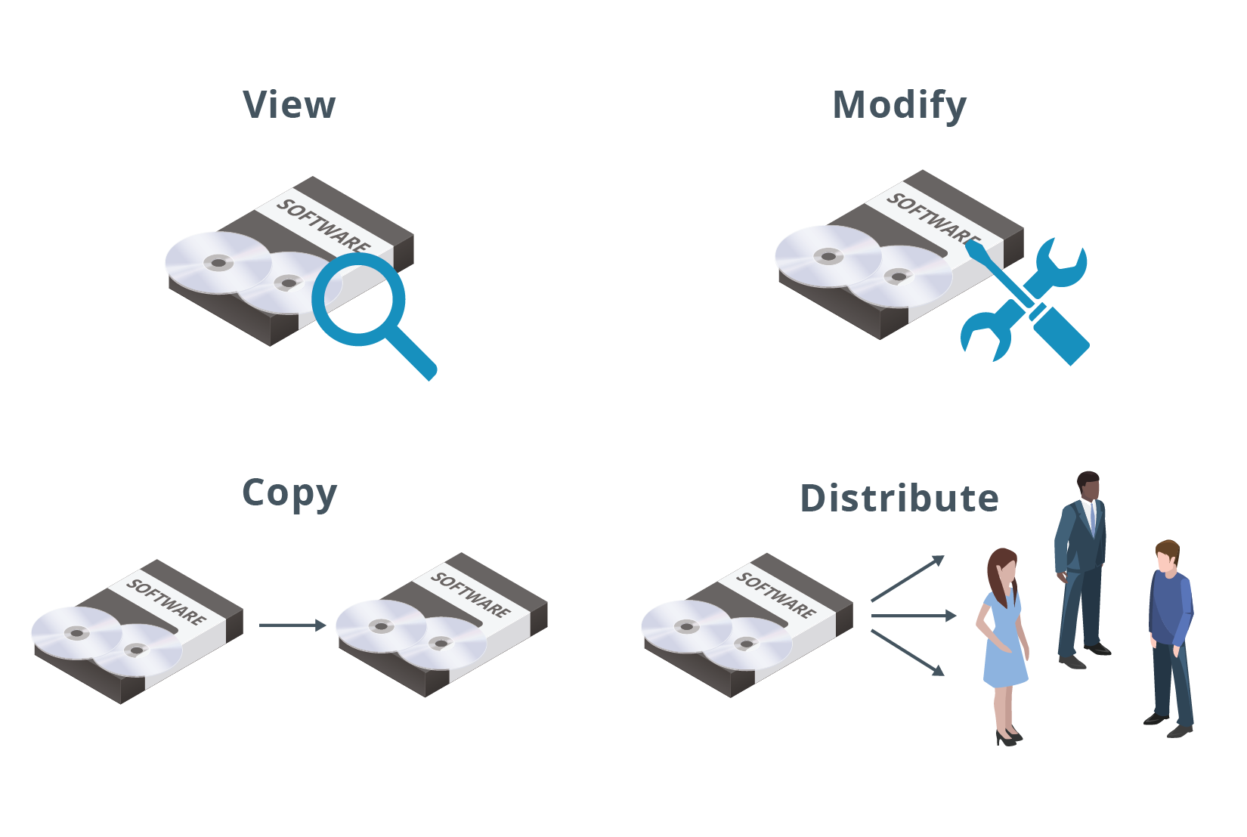
Open Source Software (Slide 2 of 2)

Slide 5
Free Software vs. Open Source Software (Slide 1 of 2)
Free software often conflated with OSS.
Very similar with a lot of overlap.
Some draw a distinction.
According to Richard Stallman:
"Open source is a development methodology; free software is a social movement."
OSS focuses on collaborative development.
Free software focuses on user rights.
"Free" as in freedom, not a lack of cost.
Free and open source software (FOSS):
Used as an alternative term.
Embodies values of both movements.

Slide 6
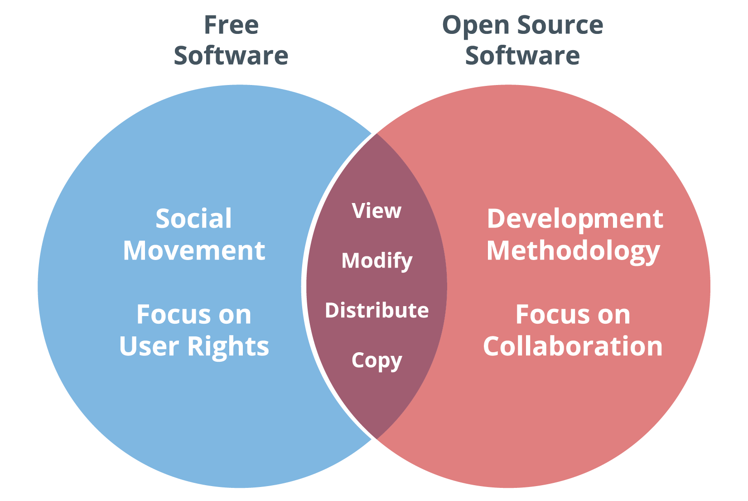
Free Software vs. Open Source Software (Slide 2 of 2)

Slide 7
The GNU Project
A free software project led by Richard Stallman.
Announced in 1983.
The first project of its kind.
Launched the free software movement.
Goal is to create an OS of only free software.
By the early 1990s, the Project had created several programs.
Most written by Stallman, like GCC and Emacs.
Other programmers created more later.
"GNU's Not Unix" is based on the design of Unix.
Doesn't include any Unix code.
Unix is proprietary.

Slide 8
The Unix Philosophy
A set of best practices and approaches to software development.
Emphasizes simplicity and modularity.
Created by lead Unix developers.
Key high-level points:
Do one thing and do it well.
Worse is better.
Support interactivity.
Handle I/O streams.
GNU software conforms to Unix philosophy.

Slide 9
The Linux Operating System Family (Slide 1 of 2)
A family of operating systems based on the Linux kernel.
Kernel is central core of OS that manages all other components.
Kernel developed by Linus Torvalds in 1991.
FOSS, GNU, and Unix play an important role in Linux's development.
Linux kernel released under GPLv2.
Most distributions add GNU software on top of kernel.
First complete OS family to qualify as FOSS.
Follows Unix principles of simplicity and modularity.

Slide 10
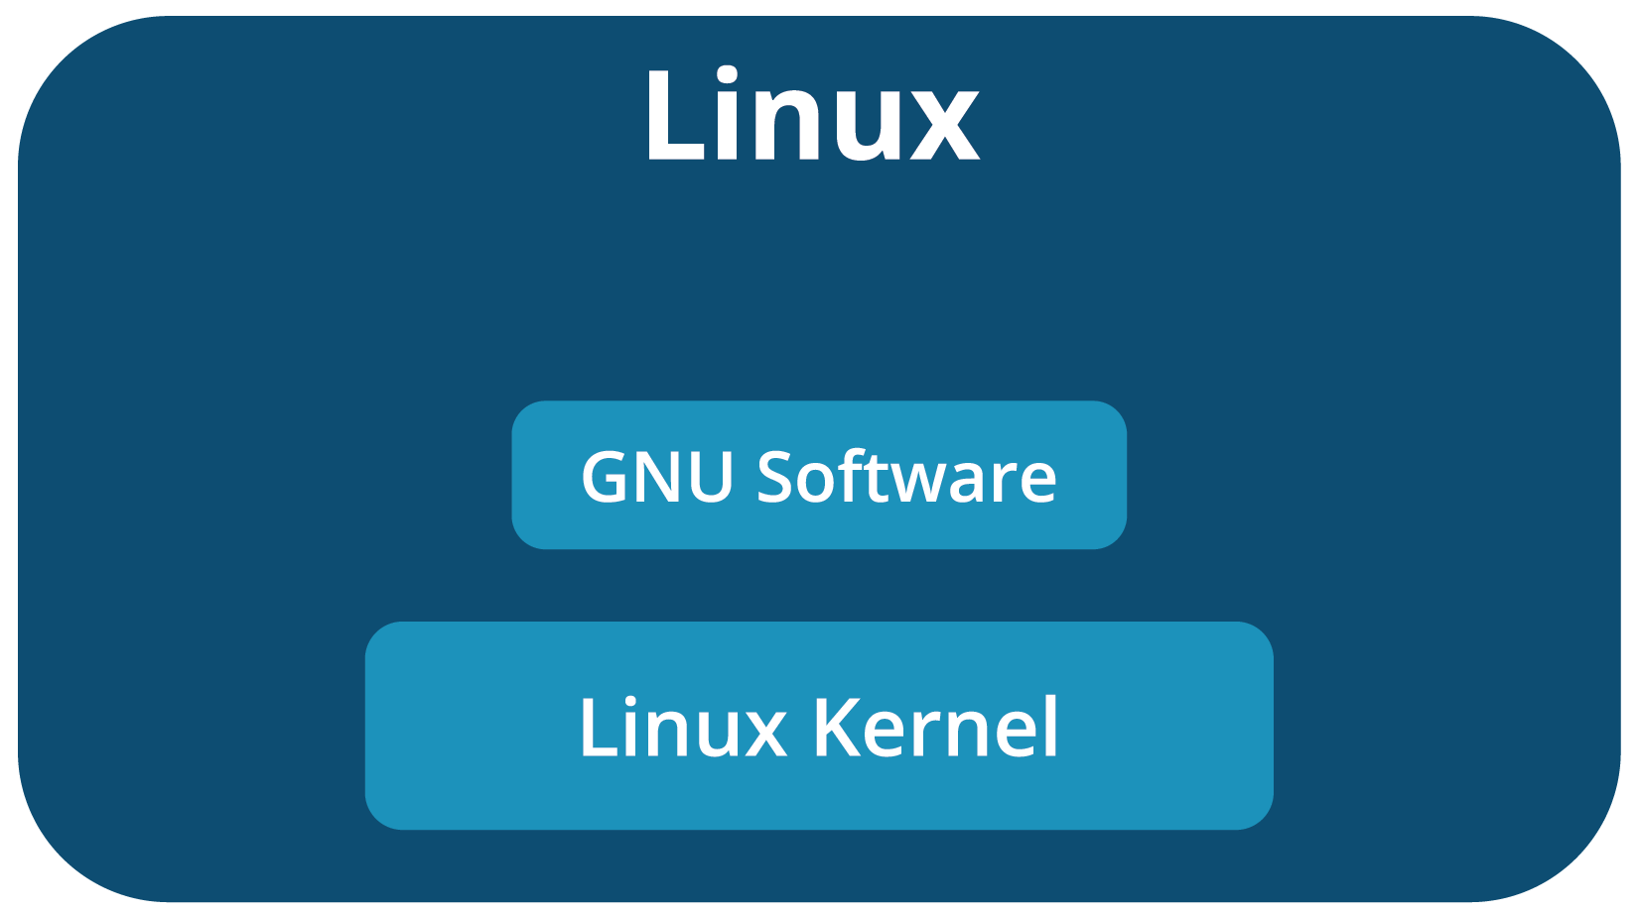
The Linux Operating System Family (Slide 2 of 2)

Slide 11
Advantages of Using Linux
FOSS nature promotes transparency.
Design emphasizes simplicity and modularity.
Highly customizable.
Highly reliable and stable.
Strong integration with common programming languages.
Emphasis on security and privacy.
Most distributions are free of monetary cost.
Has a passionate community that offers support.

Slide 12
Disadvantages of Using Linux
Sharper learning curve.
Desktop software is not as well-supported.
No official version; might confuse new users.
No official support for the most part.

Slide 13
Linux Distributions
Distinct members of the Linux OS family.
No official "Linux" OS.
All distros based on Linux kernel.
Different distros have different additional software and kernel version.
Kernel + additional software = fully functional OS.
Also differences in community, release rate, etc.
Choosing a distro is a matter of:
Identifying your business needs.
Familiarity with provided tools.
There are hundreds of distros.
Notes:
Teaching Tip: You may want to emphasize that there are two primary distribution families—Red Hat and Debian.
Teaching Tip: Consider informing students that some of the best distributions to experiment with are Ubuntu, Fedora, and CentOS.

Slide 14
List of Linux Distributions (Slide 1 of 2)
Distro | Notes
Slackware | Oldest distro still maintained. Most Unix-like, for advanced users.
Debian | Earlier distro composed entirely of free software. Basis for many derivative distros.
Ubuntu | One of the most popular distros for general use. Based on Debian.
Kali Linux | Debian-based distro. Used in penetration testing/other cybersecurity tasks.
RHEL | Comes with paid customer support. Common for servers in corporate environments.

Slide 15
List of Linux Distributions (Slide 2 of 2)
Distro | Notes
CentOS | No-cost version of RHEL. Same functionality, no support provided.
Fedora | Upstream source of RHEL. Multiple editions targeting different computing roles.
openSUSE | Sponsored by SUSE Linux GmbH. Incorporates FOSS tools.
SLES | Shares code base with openSUSE. More stable, comes with paid customer support.
Arch Linux | For experienced users; emphasizes simplicity. ArchWiki provides comprehensive documentation.

Slide 16
Uses for Linux
Role | Description
Servers | Provide services to multiple users over a network. Linux dominates web, cloud, and other server markets.
Workstations | Powerful desktops geared toward technical use. Slightly better Linux adoption than PCs.
Mainframes and supercomputers | Mainframes excel at processing concurrent transactions. Supercomputers excel at performing complex calculations quickly. Linux dominates both markets.
Mobile devices | Includes smartphones, tablets, etc. Android has over 80% of mobile device market.
PCs | Includes desktops and laptops. Only around 2% run Linux.
Embedded systems | Have specific functions in a larger system. Majority of market runs Linux.

Slide 17
Discussing the Linux Design Philosophy

Slide 18
Activity 1-1: Discussing the Linux Design Philosophy
What is the distinction between free software and open source software given by Richard Stallman, the founder of the free software movement?
ANSWER:
Open source is a development methodology; free software is a social movement. Free software refers to freedom rather than to software that has no cost associated with it.

Slide 19
Activity 1-1: Discussing the Linux Design Philosophy
What is one of the main advantages of Linux that has enabled it to be applied to many different computing roles?
ANSWER:
Linux is highly extensible, which makes it an excellent choice for computing roles as diverse as servers, workstations, mainframes, and mobile devices.

Slide 20
Activity 1-1: Discussing the Linux Design Philosophy
In which four major computing roles does Linux dominate the market?
ANSWER:
Linux dominates in mobile devices where it commands over 80% of the market; in Internet servers such as domain hosting and Amazon's EC2 platform (>90%); in embedded computing; and in mainframes/supercomputers.

Slide 21
Activity 1-1: Discussing the Linux Design Philosophy
True or false? There is a single Linux master distribution from which all other Linux sub-distributions are derived.
ANSWER:
False. There is no single master Linux distribution. There are several top-level (not derived from another distribution) distributions from which others are derived. Slackware, Debian, and Red Hat Enterprise Linux are examples of top-level distributions.

Slide 22
Activity 1-1: Discussing the Linux Design Philosophy
Which Unix philosophy states that developers should create software that is limited in functionality because it's easier to use and to maintain?
ANSWER:
Worse is better. The assumption is that limited functionality is worse than creating software that does everything.

Slide 23
Activity: Identifying the Linux Design Philosophy
You are a sysadmin at Develetech Industries.
A manufacturer of home electronics.
The CTO is considering switching company servers to Linux.
He wants to start a discussion about Linux.
What are its fundamental concepts?
What are its advantages and disadvantages?

Slide 24
Topic B: Enter Shell Commands
Exam Objectives:
This topic does not cover specific exam syllabus objectives or content examples.

Slide 25
The CLI
A text-based interface between the user and the OS that accepts input in the form of commands.
Presents prompt to user.
User enters command to interact with system.
Important tool in any admin's arsenal.
Developers and admins use CLI, end users tend to use GUI.
Comfort at CLI is essential, and an assumed skill.
A GUI is not required, and may not even be installed.
You can perform all administration at the CLI.

Slide 26
CLI Advantages and Challenges
Advantages:
Faster for system to process.
Faster for admins to enter info.
Commands can be stored as scripts to run a series of tasks.
Scripts can be scheduled to run on a regular basis.
Additional options available that may not be in GUI.
Challenges:
More difficult to learn than GUI.
Commands have many options and are not always consistent.
Often mistakenly thought of as legacy.
Many command-line environments in different OS platforms.

Slide 27
Shells (Slide 1 of 2)
A system component that permits users to pass commands and information to the kernel.
Interpreter between human and kernel languages.
Users issue commands in shell to tell OS what to do.
OS responds with results.
Can be either CLI or GUI.
CLI shells:
Bourne shell
Bash
C shell
KornShell

Slide 28
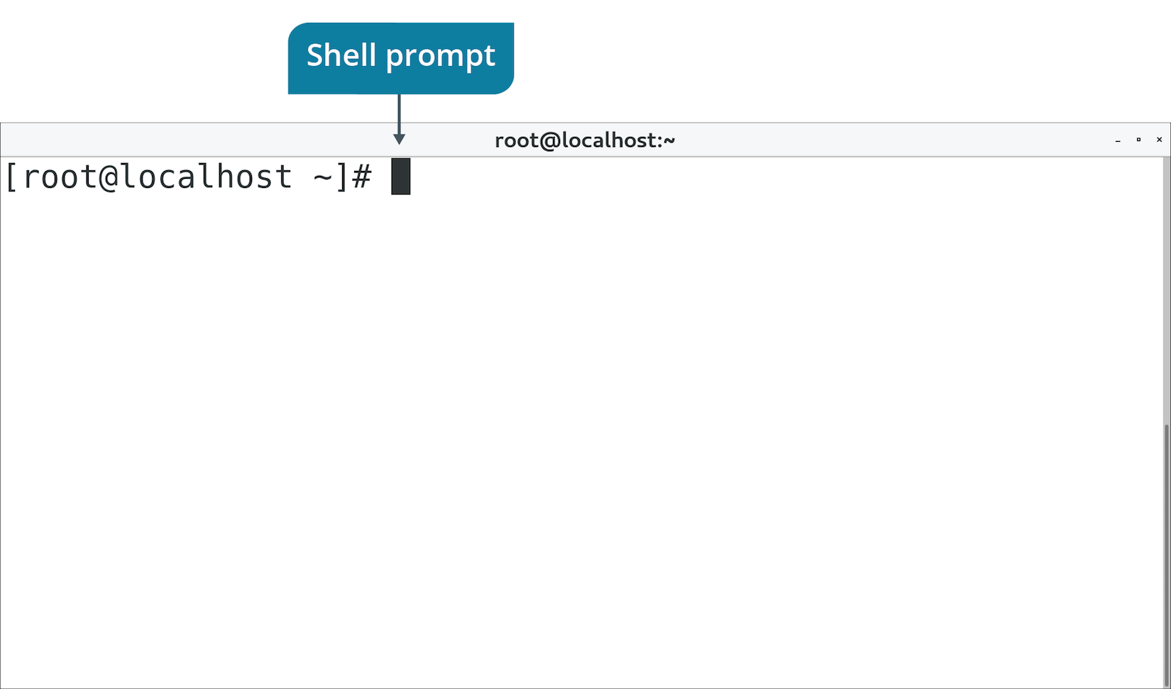
Shells (Slide 2 of 2)

Slide 29
Bash Syntax (Slide 1 of 2)
Basic syntax: command [-options] [arguments]
Syntax Format | Command | Description
Command only | ls | Lists directory contents with default output.
Command with options | ls –la | Lists directory contents in long format/shows hidden files.
Command with argument | ls /var/log | Lists directory contents of /var/log with default output.
Command with options and argument | ls –la /var/log | Lists directory contents of /var/log in long format/shows hidden files.

Slide 30
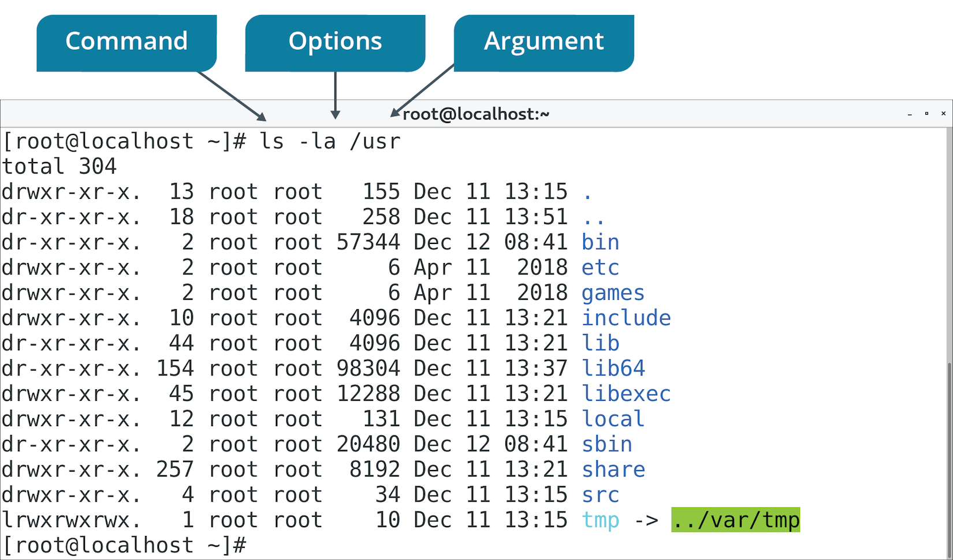
Bash Syntax (Slide 2 of 2)

Slide 31
Basic Bash Commands
Command | Description | Examples
echo | Repeats input back to user. | echo 'Good morning!'
ls | Lists contents of directory. | ls ls -a ls -l ls /var/log
pwd | Displays current working directory. | pwd
cd | Changes current working directory. | cd /var/log cd /etc
touch | Updates timestamp of file/creates file. | touch file1
cp | Copies a file or directory. | cp file1 file2
mkdir | Creates a new directory. | mkdir newdir

Slide 32
File Viewing Commands
System configs are in text files.
cat views contents of file.
Example: cat file1 shows contents of file1 on screen.
less breaks output into pages.
Example: less file1 shows contents even if they go past screen.
Press Page Up/Page Down to scroll.
Press q to exit.
Notes:
Teaching Tip: You may wish to mention the more command, though it will be discussed in a later lesson.

Slide 33
File Editing Commands
vim
vim file1 to open file.
Press i to insert.
Press Esc to leave insert.
:wq to save/quit.
nano
nano file1 to open file.
Enter text directly.
Press Ctrl+O to save.
Press Ctrl+X to quit.
gedit
Select Applications→Accessories→Text Editor.
Enter text directly.
Use menu to save/quit.

Slide 34
Power Management Commands
shutdown -h now
Shuts down with no delay.
shutdown -h -t 90
Shuts down in 90 seconds.
shutdown -r now
Reboots with no delay.
Notes:
Teaching Tip: Consider mentioning that it is not as common to reboot Linux as it is to reboot a Windows system.

Slide 35
Superuser Commands
Superuser has admin credentials.
Typically named root.
Avoid logging in as root.
Sometimes you'll need to assume superuser privileges.
su – switches/substitutes user credentials.
su - root switches/substitutes to root user.
System will prompt you for root password.

Slide 36
Shell History
Bash keeps a history of commands entered.
Use to repeat commands.
Examples:
history outputs list of recently entered commands.
Up/Down Arrow keys cycle through history. Press Enter to reissue command.

Slide 37
Tab Completion
A feature in which a command-line shell fills in the name of a command you've partially typed.
Supported by Bash.
Reduces errors and speeds up entering commands.
Examples:
Type his and press Tab to fill rest of history command.
Type cd /home/user1/Aug and press Tab to fill path to:
cd /home/user1/AugustProjects

Slide 38
Shell Tips and Tricks
Get in the habit of using tab completion.
Use history instead of re-writing long commands.
Read the command backward to troubleshoot issues.
Clear the screen with the clear command.

Slide 39
Discussing Shell Commands

Slide 40
Activity 1-3: Discussing Shell Commands
True or false? In Linux, Equipment.txt and equipment.txt refer to the same file.
ANSWER:
False. Linux file names are case-sensitive. These are two different files.

Slide 41
Activity 1-3: Discussing Shell Commands
Which command enables a user to log in to a system with their own credentials, and then to become the root user to perform administrative tasks?
ANSWER:
su —The su command enables an authorized user to become the root user.

Slide 42
Activity 1-3: Discussing Shell Commands
A fellow administrator calls you and needs you to check the /etc/shadow file for a new user's entry, confirming that it indeed exists. How would you look at the contents of the /etc/shadow file without the possibility of changing the file?
ANSWER:
1) su – 2) cat /etc/shadow —You first have to become the root user because the /etc/shadow file can only be read as root. To look at the file without the possibility of altering its contents, use the cat command to list its contents to the screen.

Slide 43
Activity 1-3: Discussing Shell Commands
You need to quickly create an empty file (log.txt) so that an application can copy data into it. Which command can you use to create the file?
ANSWER:
touch log.txt

Slide 44
Activity 1-3: Discussing Shell Commands
You recall that a few days ago, you ran a command that helped you find a filtered list of files on the file system. You don't remember the command's somewhat complex syntax. How can you reproduce the command without searching the Internet for the correct syntax again?
ANSWER:
Use the Up Arrow key until you find it and then press Enter to execute it. The Up Arrow key scrolls back, one command at a time, through your command history.

Slide 45
Activity: Entering Shell Commands
CTO is considering switching servers to Linux.
He wants you to become familiar with using Linux.
You'll boot up a test machine and try it out.
You'll start by entering basic commands at the Bash shell.

Slide 46
Topic C: Get Help with Linux
Exam Objectives:
This topic does not cover specific exam syllabus objectives or content examples.

Slide 47
Linux Documentation
Documentation is a necessity.
Helps users perform activities and resolve issues.
Any job role or experience level.
No official comprehensive source of Linux documentation.
Spread across multiple sources in multiple forms.
Example sources:
Manual pages
Built-in help commands
Online documentation projects
Usenet newsgroups
Internet mailing lists
Q&A websites
Forums/social media
Books/other print resources

Slide 48
Manual Pages (Slide 1 of 2)
The complete documentation for specific Linux commands.
Available on Linux systems by default.
Use the man command to display pages.
Include information such as:
Syntax
Description
Options
Example usage
Related commands
Most immediate source of help for commands.
Useful when you have no Internet access.
Can be difficult to parse for new users.

Slide 49
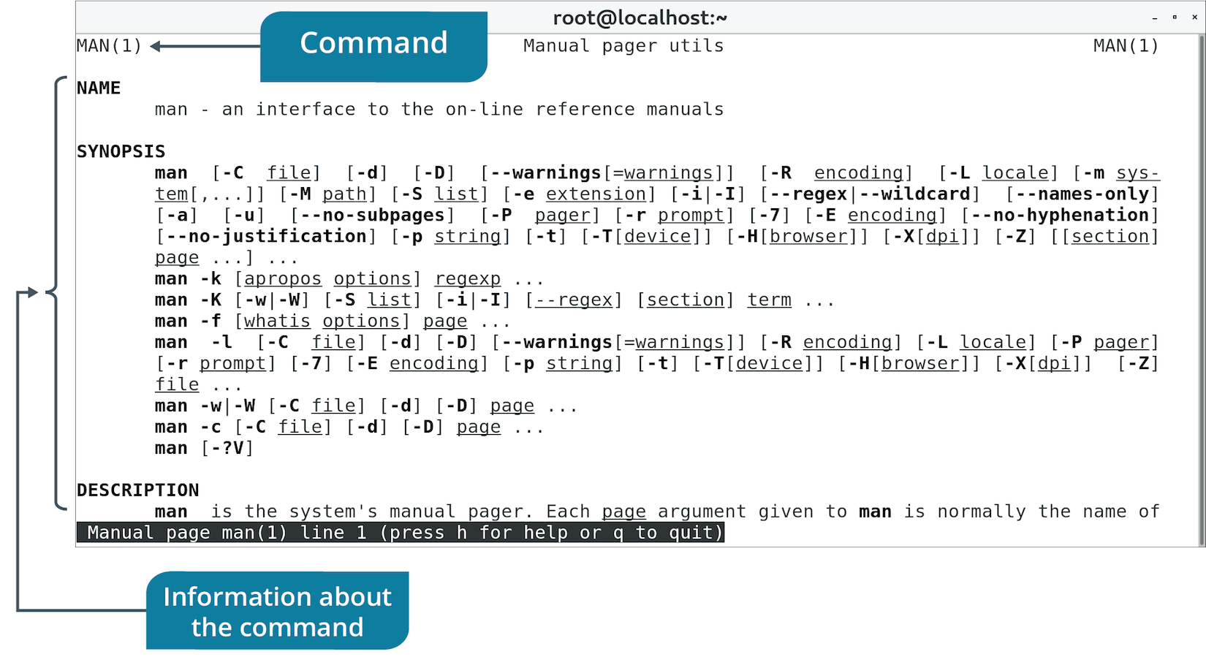
Manual Pages (Slide 2 of 2)

Slide 50
Other Built-In Help Options
Help Option | Description
apropos | Searches NAME section of man pages based on keyword. Helps you find the right command to use for a certain task. Syntax: apropos {keyword}
whatis | Displays brief description of given command. Helps you figure out what a command does. Syntax: whatis {command}
info | Displays info page of command. Similar to man pages, with some improvements. Not as widely adopted as man pages. Syntax: info {command}
--help | Displays quick summary of command usage and arguments. Syntax: <command> --help
/usr/share/doc/ | Directory of documentation for software packages. Includes author, licensing, installation, README, etc.

Slide 51
Online Documentation (Slide 1 of 2)
Online Source | Description
Official distro documentation | Some distros provide official documentation for that distro. Includes release notes, installation guide, etc.
LDP | All-volunteer project for comprehensive Linux documentation. Provides HOWTOs, Guides, FAQs, man pages, etc.
Linux man-pages project | Official man pages for Linux kernel/C library function interfaces available to user space programs.
GNU coreutils manual | Official source of documentation for GNU core utilities. coreutils is GNU software package compiled with Linux kernel.

Slide 52
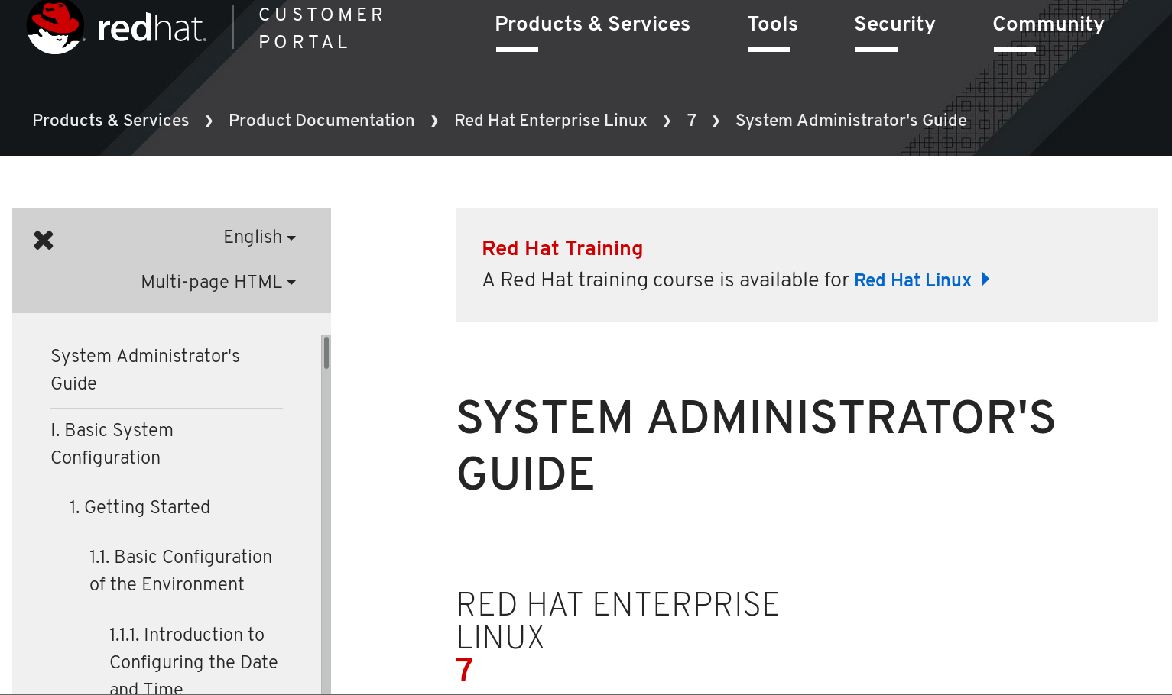
Online Documentation (Slide 2 of 2)

Slide 53
Interactive Help
Online Source | Description
Usenet newsgroups | Online discussion similar to bulletin board systems. Users post to group in threads. comp.os.linux.help, comp.os.linux.answers, comp.os.linux.admin
Mailing lists | Similar to newsgroups but threads are sent over email. Some distros have their own mailing lists. General mailing lists: https://lists.linuxfoundation.org/mailman/listinfo
Q&A websites | Users post questions and other users provide answers/comments. Posts are "liked" or "upvoted" by community. Example: https://unix.stackexchange.com/
Forums and social media | Threaded posts using web protocols. Some forums encourage questions and discussion on Linux topics. Example: https://www.linuxquestions.org/ Social media sites can provide forum-like discussion platforms. Example: https://www.reddit.com/r/linuxquestions/

Slide 54
Discussing Help in Linux

Slide 55
Activity 1-5: Discussing Help in Linux
Since Linux is generally community (user) supported, name three sources of Linux documentation.
ANSWER:
Any three of the following: Manual pages, built-in help commands, online documentation projects, Usenet newsgroups, Internet mailing lists, question and answer websites, forums and social media, and books and other print resources.

Slide 56
Activity 1-5: Discussing Help in Linux
To access complete local documentation, which command can you enter at the command-line to access extensive usage information on the cp (copy) command?
ANSWER:
man cp

Slide 57
Activity 1-5: Discussing Help in Linux
A coworker sends you an instant message and asks you how to appropriately format a manual page for the mv command so that she can send it to the printer and get readable output. What command can she enter?
ANSWER:
man –t mv

Slide 58
Activity 1-5: Discussing Help in Linux
Which online documentation site provides a comprehensive resource for Linux documentation including manual pages, FAQs, HOWTOs, and other types of documentation?
ANSWER:
The Linux Documentation Project (https://www.tldp.org)

Slide 59
Activity 1-5: Discussing Help in Linux
If you know the name of a command and want to know what its function is, which command would you use to find out?
ANSWER:
whatis

Slide 60
Activity: Accessing Help in Linux
Linux must have tools with certain capabilities.
Wants to be able to easily search the contents of text files.
Analyze log files, scripts, etc.
Look for specific patterns.
You need to find one or more tools that can do this.
You'll consult various help resources.

Slide 61
How is Linux used in your organization? Are there any existing systems that could benefit from switching to Linux?
What is your preferred method for getting help with Linux, and why?

